Slide 1
2023 Fall Business Meeting October 20, 2023

Slide 2
Agenda
1. Call to Order and Welcome- Mary Pat Harnegie
2. Approval of Minutes from Spring 2023 Business Meeting- Tom Hayes 3. Officer Reports/Committee Reports
Past President’s Report- Mandy Neudecker
President’s Report- Mary Pat Harnegie
President-Elect/Program Committee Report- Stacy Gall
Membership and Treasurer’s Reports- Shelley Ivary
Web Administrator’s Report- Leslie Lindsey
Communications Committee Report-Catherine King
Archives Report- Diane De Luco
Sydelko Scholarship Report- Ellen Franks
Midwest Chapter MLA Report- Mary Pat Harnegie
NNLM Region 6 Update- Neil Nero
4. Old business/New business
5. Call for motions to adjourn

Slide 3
Treasurer’s report

Slide 4
Membership Report (as of 10/12/23)
Members
Active 52 (decrease of 2), 51 Regular, 1 Library Student
16 Renewal Overdue
14 Lapsed
New Members
Jess Elder, Cedarville University
Beth St. John, OhioHealth Riverside Methodist Hospital

Slide 5
Region 6 Update OHSLA Annual Meeting October 20, 2023
Notes:
Thanks so much for dedicating time during your meeting for this NNLM Region 6 update.

Slide 6
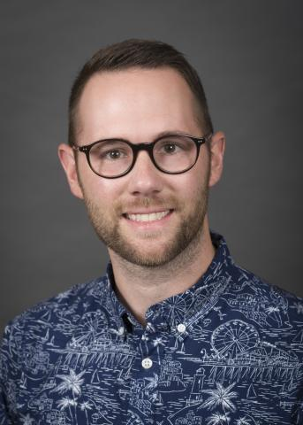
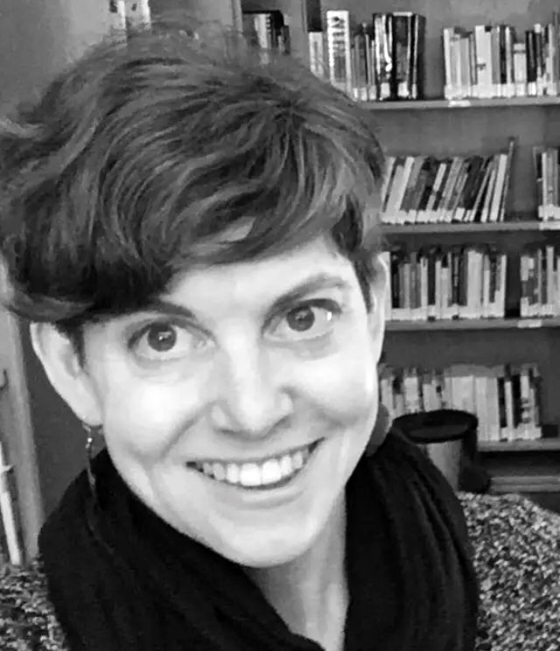
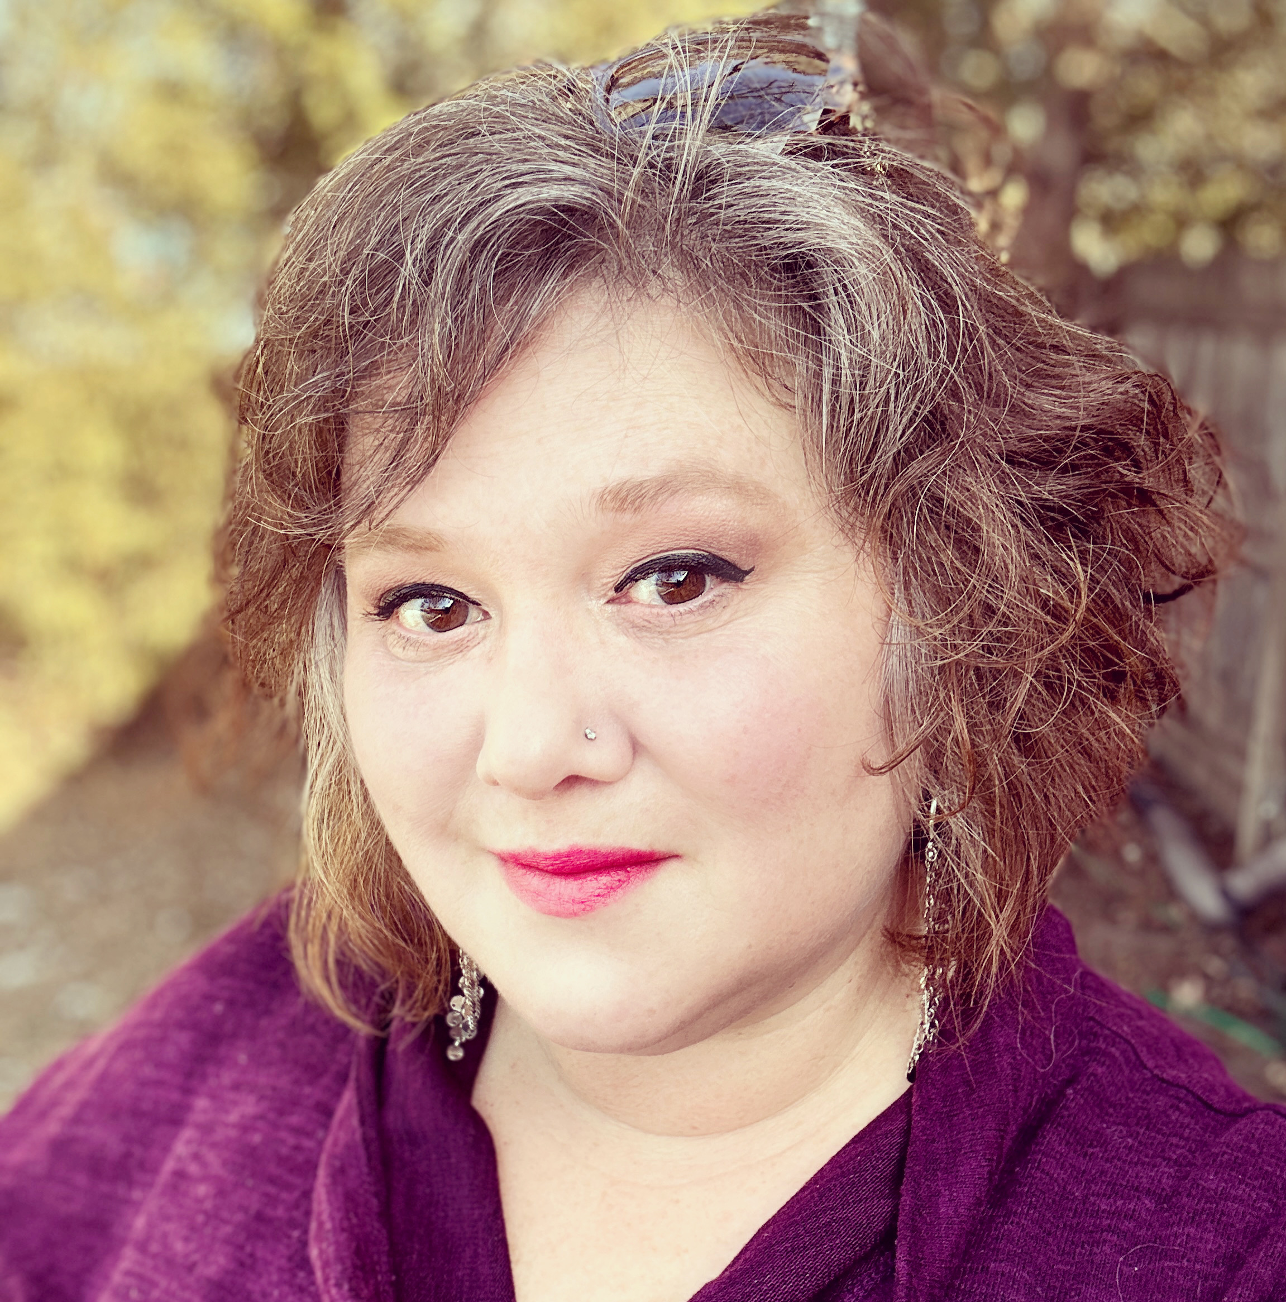
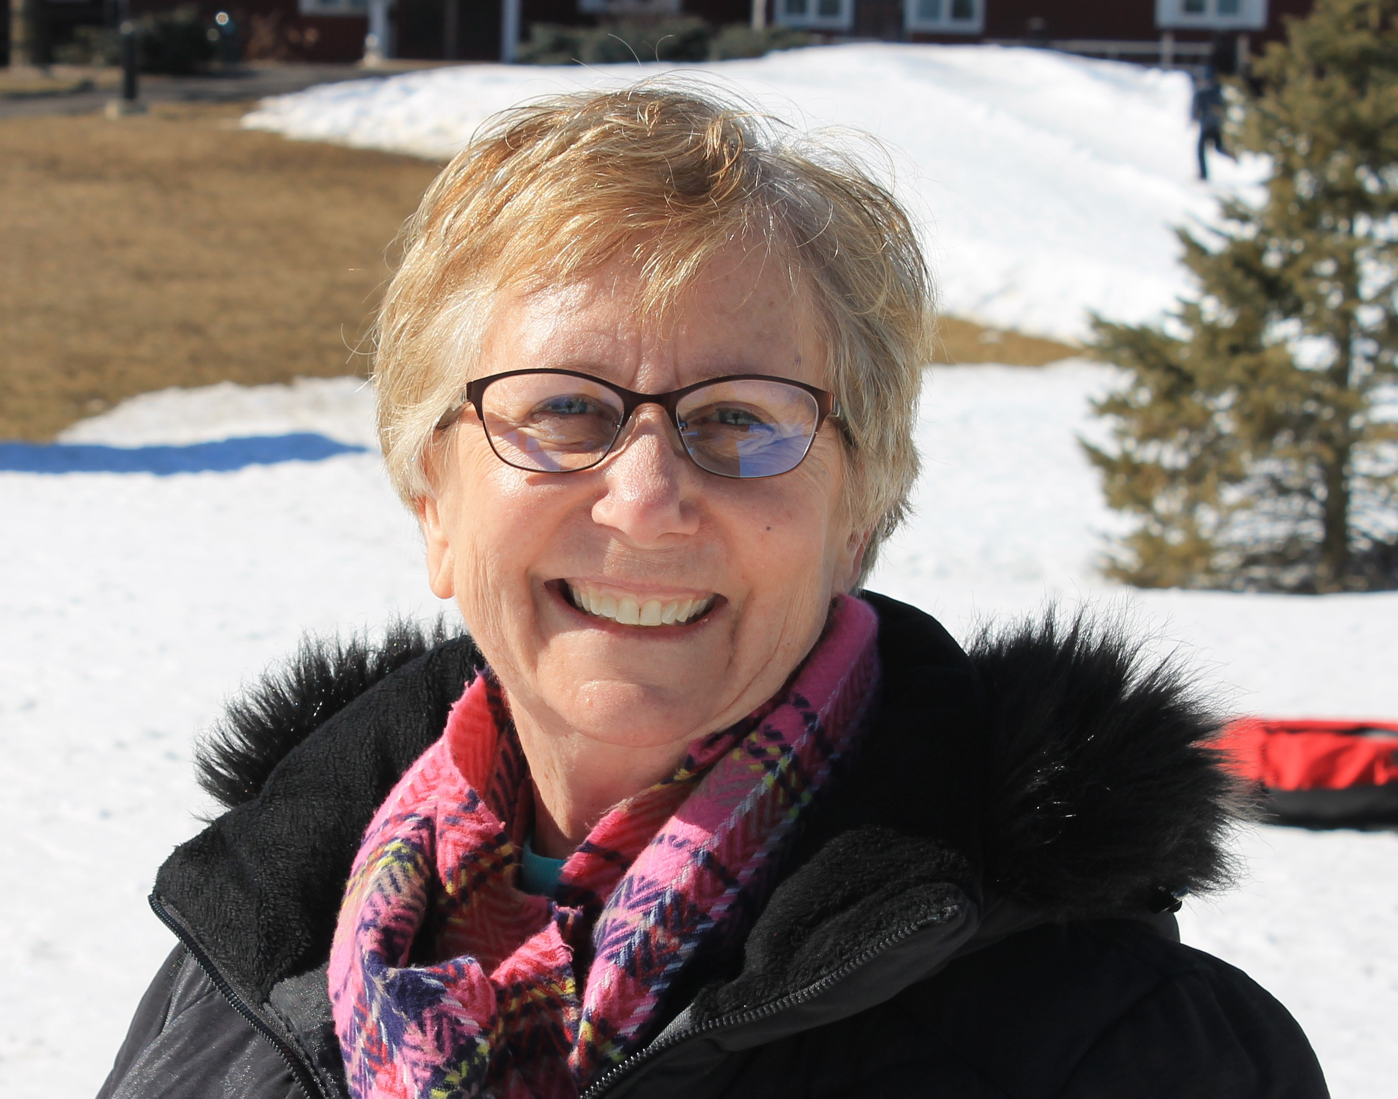
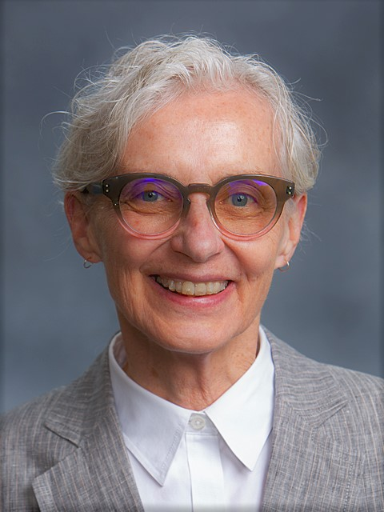
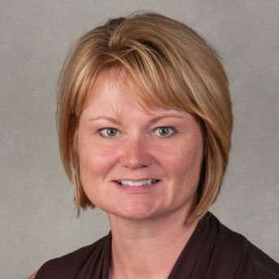
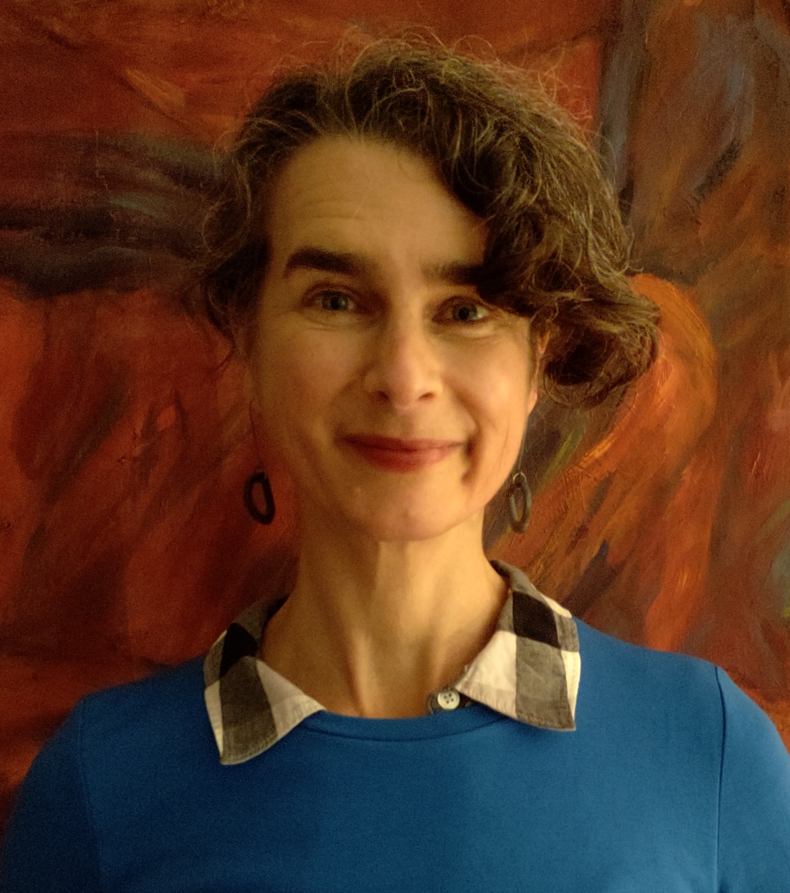
Our Team
Miles Dietz-Castel
Communications
Nora Barnett
Health Professionals
Bobbi Newman
Public Libraries
Linda Walton
Executive Director
Jacqueline Leskovec
Membership
Darlene Kaskie
Community Outreach
Erica Lake
Medical & Academic
Notes:
I’m sharing this update on behalf of your Region 6 team.
This update will cover recently launched training and engagement opportunities, as well as those we have planned through April 30, 2024.

Slide 7
Classes in Development
NIH Public Access Policy for Librarians
Mental Health in the Workplace
Complimentary and Integrative Health
Notes:
NNLM offers a wide-variety of live classes, asynchronous courses, webinars, and educational events, many of which offer free CE.
We are currently developing several new classes which will launch between January and March of 2024.
One will focus on the NIH Public Access Policy. Because much of the instruction and training that’s currently available is geared for researchers, this course will offer practical guidance expressly for LIBRARIANS who support researchers in submitting publications to comply with the NIH public access policy.
We’re also developing a class on resources for mental health at work, which will offer an understanding of the recommendations, steps, and resources available to promote mental health and well-being in the workplace.
And we have a new class on complementary and integrative health in the works. Participants will learn how to critically evaluate Complementary and Integrative information and resources so that they can assist patrons in locating quality resources.

Slide 8
New: Telehealth Moodle and Webinar Series
Infrastructure and technology
Privacy and ethical considerations
Library health information resources
Notes:
In June, we launched a new Moodle course called, Telehealth 101: What Libraries Need to Know.
This course addresses one of our NNLM national initiatives on bridging the digital divide by exploring how telehealth can increase access to quality healthcare. The course addresses privacy and ethical concerns, the technology and infrastructure needed to launch a successful telehealth program and describes different roles libraries can have supporting telehealth.
When this launched in June, it filled up so quickly that another session was added for July, and that session ALSO filled up quicky! Stay tuned for when this will be scheduled again in Year 3.
And NNLM’s new Bridging the Digital Divide: Telehealth and Libraries webinar series launched earlier this month. The next one will take place on December 5, and will examine telehealth’s double-edge sword – it’s potential to reduce health inequities by increasing access to healthcare while also exacerbating structural inequities.

Slide 9
Updated: ClinicalTrials.gov for Librarians
Modernized ClinicalTrials.gov website
Next class: January 31, 2024
Notes:
Who has had a chance to check out the modernized ClinicalTrials.gov website?
It went live on June 21. To allow everyone time to adapt, the classic ClinicalTrials.gov website will remain available until it’s retired sometime in 2024.
We will demo the new site in the next session of our ClinicalTrials.gov for Librarians class on January 31, 2024 - registration is now open.

Slide 10
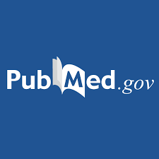
Bone up on PubMed!
How PubMed Works series in November:
Introduction Nov. 7
Selection Nov. 9
MeSH Nov. 14
ATM Nov. 16
Notes:
If you need to bone up on your PubMed skills, we will be offering live sessions of our How PubMed Works series in November.
The series consists of four 60-minute classes, each focusing on a different PubMed topic: Intro, Selection, MeSH, and Automatic Term Mapping.
Each class is free-standing and independent, so you can take just one or take all of them.

Slide 11
NNLM Data Carpentry Workshop
February 19-20, 2024
Fundamental data skills
For those with little to no computational experience
Notes:
Region 6 and Region 4 will join forces with NNLM’s National Center for Data Services to host a Data Carpentry workshop, February 19-20, 2024.
The two-day workshop is intended for those with little to no prior computational experience, and will focus on fundamental data skills, and participants will get to try their hand at data organization, cleaning, analysis, and visualization.

Slide 12
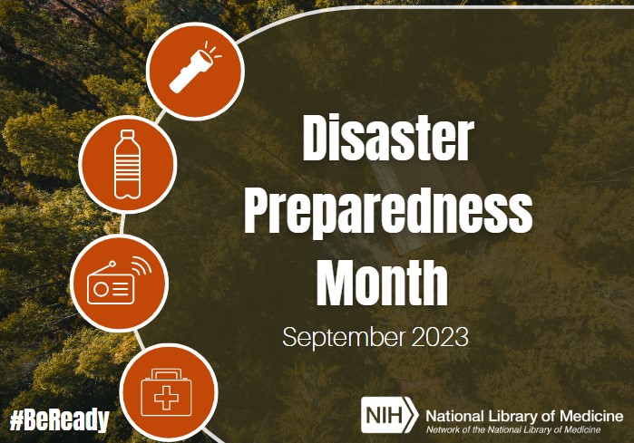
NNLM Forum on Disaster Preparedness
Notes:
I hope some of you were able to make the sessions we offered last month as part of NNLM’s virtual disaster preparedness forum.
We had some fantastic speakers presenting on tools and resources, disaster planning communication, and institutional preparedness – all with a focus on greater inclusiveness and community resilience.
The presentations were recorded and are now available on NNLM’s YouTube channel, and they have also been added to our on-demand Moodle class, Disaster Planning Recorded Webinars.

Slide 13
NNLM Environmental Determinants of Health Webinar Series
Launching January 2024
New national webinar series
Notes:
We have another new webinar series that will launch in January 2024 focused on environmental determinants of health, which is another NNLM national initiative.
This series will explore a wide range of topics, including socioeconomic factors, natural and built environment influences, pollution, climate change, disaster information management, mental and emotional well-being, rural and urban health considerations, tribal health disparities, access to healthcare, health advocacy, and sustainability.

Slide 14
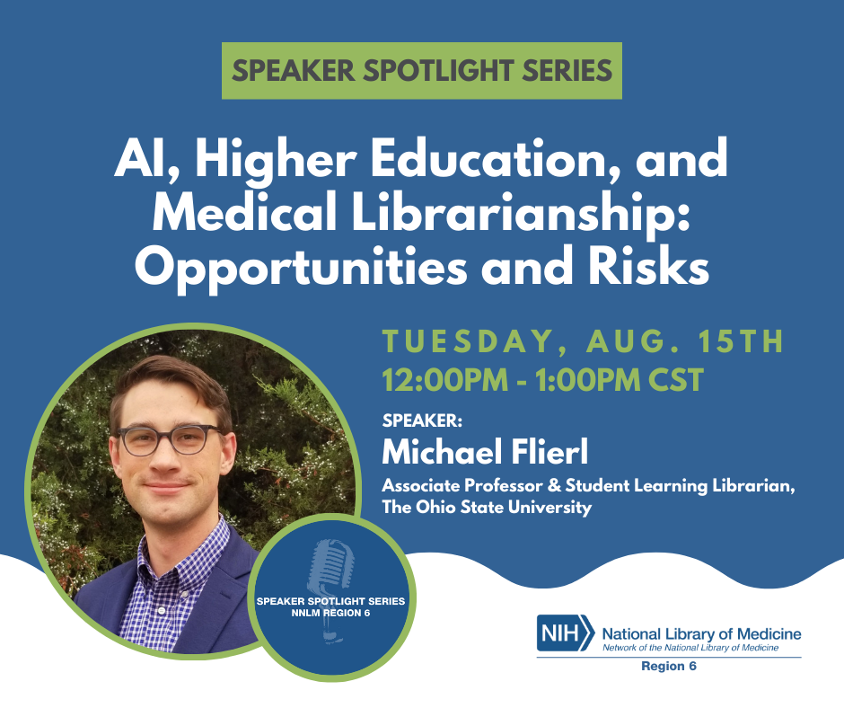
Region 6 Speaker Spotlight Webinar Series
Notes:
Our Region 6 Speaker Spotlight Series is still going strong.
This series allows us to address pressing concerns, emerging trends, and timely topics by bringing in w wide-variety of expert guest speakers.
Coming up next will be, Holding Space to Discuss a Complicated Past: Exploring Medical Libraries’ Role in Perpetuating Racial Science, on November 17th.

Slide 15
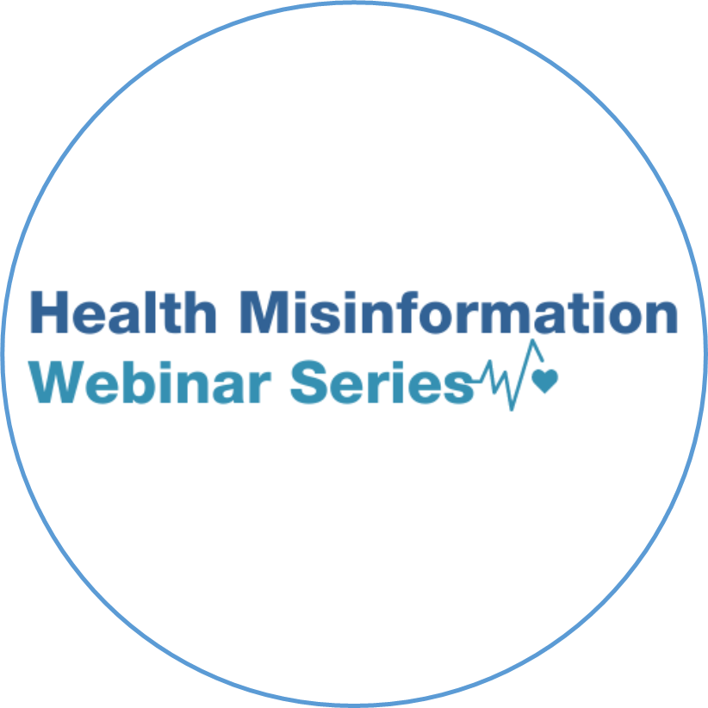
NNLM Health Misinformation Webinar Series
November 1
Deciphering the Social Media Pulse: Twitter's Role in Shaping COVID-19 Health Beliefs and Vaccine Perceptions
Notes:
I hope some of you were able to join us in April for our multi-day virtual symposium on health misinformation. Well, we’ve been keeping the conversation going since then with our national Health Misinformation Webinar Series.
These webinars feature expert guest speakers presenting on various aspects of health misinformation and offer practical and evidence-based solutions for how to identify it and help curb its spread.
These webinars are not on a set schedule, but we have been offering them just about every month.
Our last one for 2023 will be on November 1st - Deciphering the Social Media Pulse: Twitter's Role in Shaping COVID-19 Health Beliefs and Vaccine Perceptions.

Slide 16
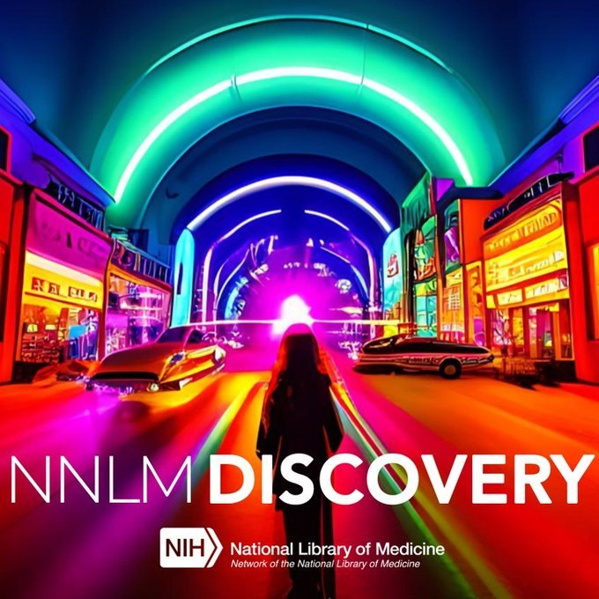
NNLM Discovery Podcast
Explores how NNLM is engaging with communities to provide access to trusted information to improve the public's health
Currently 11 episodes
Notes:
In addition to classes and webinars, NNLM also provides educational opportunities through podcasts and book clubs.
The NNLM Discovery Podcast launched in February and there are currently 11 terrific episodes, running the gamut from AI research to Wyoming bookmobiles.
Region 6 contributed an episode entitled, Period Poverty, which shares the story of Dr. Julie Chaya’s initiative to combat period poverty. She led initiative to pilot a health equity program providing free menstrual health supplies, education, and resources in her community of Mansfield Ohio.
New podcasts are being developed for this year.
If you enjoy podcasts, give all the Discovery episodes a listen!

Slide 17
NNLM Reading Club
Toolkit to help librarians be engaged partners
New keyword search function
MLA book chapter in the works
Notes:
The NNLM Reading Club is an online toolkit that provides all the resources you need to host community programming centered on health - books on different health topics, ready-to-use discussion guides and promotional materials, health information from NLM, and program ideas.
It’s not new this year – it launched in 2018 – but there are a couple things in store for Year 3, including adding a search feature to the reading club website, and a chapter in a soon-to-be released MLA book discussing the evidence-based approach for using book clubs to engage individuals and communities in health conversations.
October’s topic is addiction and recovery, and three terrific books were chosen to bring awareness to this subject - check out the Reading Club website for more information.

Slide 18
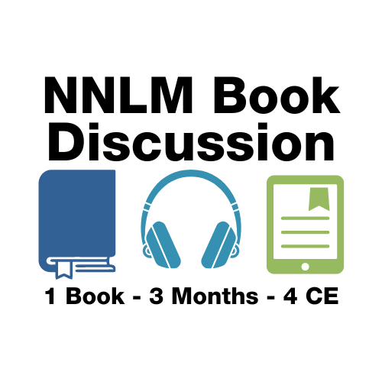
NNLM Book Discussion
November 1, 2023 - January 31, 2024
Palaces for the People: How Social Infrastructure can Help Fight Inequality, Polarization, and the Decline of Civic Life
Eric Klinenberg
Notes:
We also have the NNLM Book Discussion program. It is not for external community programming – it is for you.
A new book is selected each quarter - the next one, Palaces for the People: How Social Infrastructure can Help Fight Inequality, Polarization, and the Decline of Civic Life by Eric Klinenberg, is shown on the slide.
You can earn four MLA CE credits by participating in online or live discussions over each three-month session.

Slide 19
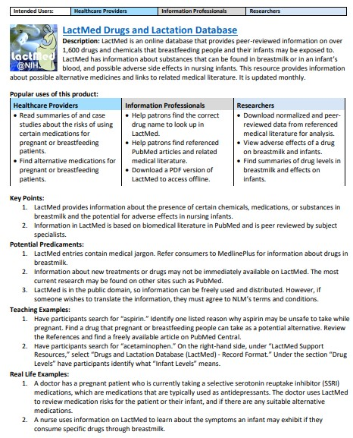
NLM Product Guides
DailyMed
LactMed Drugs and Lactation Database
MedlinePlus and MedlinePlus Espanola
MedPix
NLM History of Medicine
NLM Scrubber
PubChem
RxNorm and RxNav
Notes:
You may not know about the terrific NLM product guides that are now available on our website.
The guides provide instructors – like librarians - with examples and ideas for teaching people about different NLM products.
Each guide can be downloaded as a PDF, and includes a brief description of the product, popular uses, key points, potential predicaments, teaching examples, real-life examples, and links to more resources.
I’ve listed a few of the guides on the slide – you can link to all 19 of them on our website.

Slide 20
NNLM Health Misinformation Resource Guide
New comprehensive guide
Collection of resources, tutorials, presentations, and more
Notes:
We have a variety of other resource guides.
Last month, our new comprehensive health misinformation resource guide went live.
You can utilize the collection of resources to address health misinformation in your professional work, and to help ensure accurate and reliable health information reaches those who most need it.
We are currently working on a new guide that will launch in 2024 on NLM Products to Support Systematic Reviews.
This guide won’t be focused on how to perform a systematic review, but on how to document, save, share, update, and reproduce systematic reviews that are conducted with NLM products like PubMed and ClinicalTrials.gov.

Slide 21
Partner Outreach Program
15 ambassador organizations
Partnering to expand outreach and increase membership
Identifying health information needs at the community level
POP!
Notes:
Now I’ll move on to talk about some partnerships Region 6 will be focused on in Year 3.
POP, our Partner Outreach Program, is going strong, with 15 ambassador organizations representing each of the seven states in Region 6.
This program is focused on bringing together organizations who are in need of NNLM resources and those who know how to share them.​
Our POP organizations identify potential partners and then leverage their community connections to promote our training, funding, and engagement opportunities.
Your Ohio POP ambassador organizations are the Northeast Ohio Black Health Coalition, Restored Visions, The Ohio State University Health Sciences Library, and the University of Cincinnati Health Sciences Library.

Slide 22
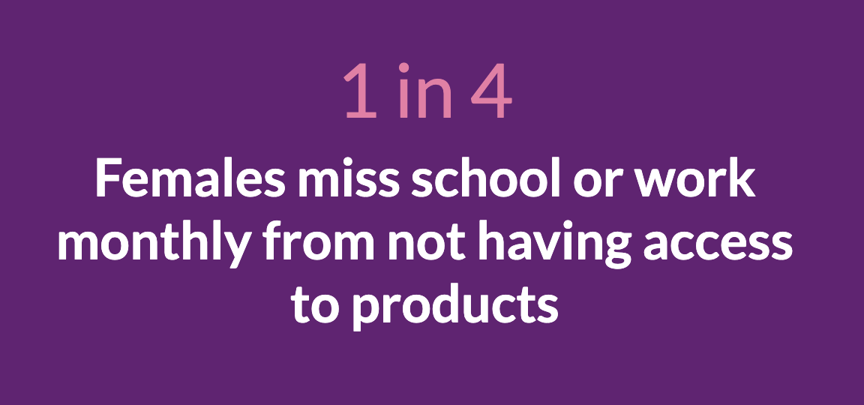
State Advisory Groups Ohio: Menstrual Health
Raise awareness for period equity
Reduce stigma surrounding menstruation
Share trustworthy health information
Notes:
Our State Advisory Groups – or SAGs - launched in 2022, and they recently drafted specific projects to work on this year to address pressing health needs in their communities.
The Ohio SAG decided to develop an information campaign for menstrual health information with public libraries throughout Ohio. It is estimated that nearly two-thirds of menstruators in the United States can not afford period products. In 2021, Forbes reported that one in ten college students couldn’t afford pads or tampons. And while government aid offers forms of financial relief to those who need it, neither food stamps or WIC, unfortunately, cover the cost of period products.
The campaign will help
Raise awareness for period poverty and how it negatively impacts population groups
Reduce stigma associated with menstruation
Share trustworthy and easy-to-read information to make informed decisions about one’s personal health

Slide 23
Thank you!
erica-lake@uiowa.edu
This project has been funded in whole or in part with Federal funds from the Department of Health and Human Services, National Institutes of Health, National Library of Medicine, under Grant Number UG4 LM013729 with the University of Iowa.
Notes:
And that’s it for the update!
Erica Lake is your liaison to hospital and academic health sciences librarians, so please reach out to her with your questions and comments.
Thank you.

